Slide 1
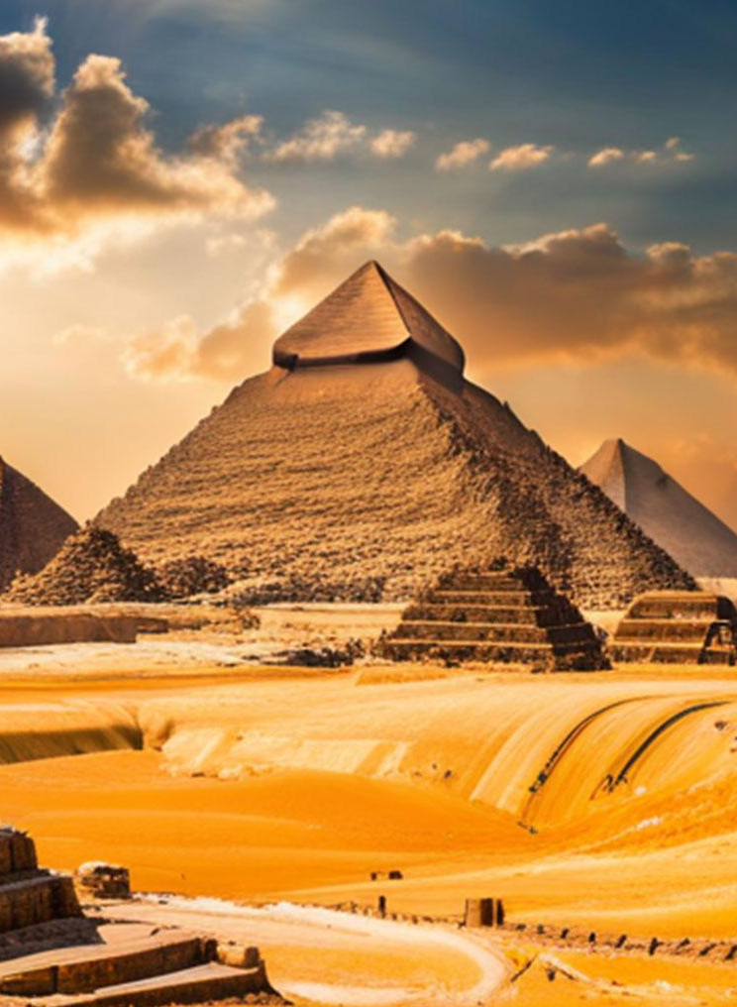
Vivid Voyages
Tourism application
Jomana El khatib 58-4193
Youmna Labib 58-15205
Dana Tamer 58-4838
Alia Alaa 58-21705
Hagar Al-Abhar 58-2787

Slide 2
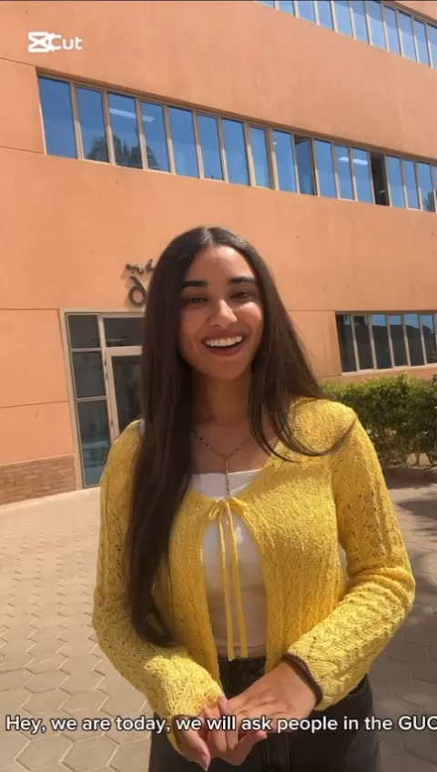
Introduction

Slide 3
TABLE OF CONTENTS
Project Summary
Demo
1
2
Project Results
Lessons Learned
3
4
Recommendations
Conclusion
5
6

Slide 4
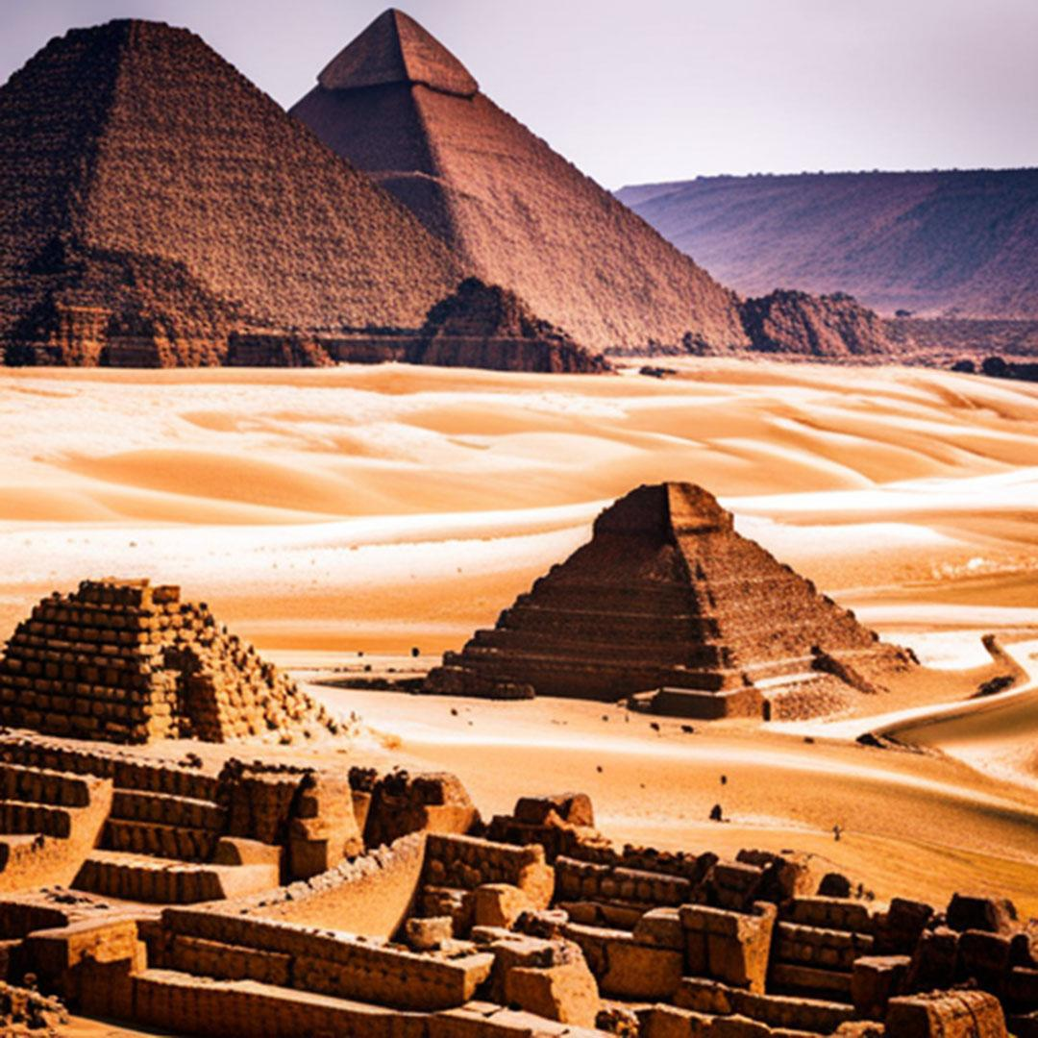
1
Project Summary

Slide 5
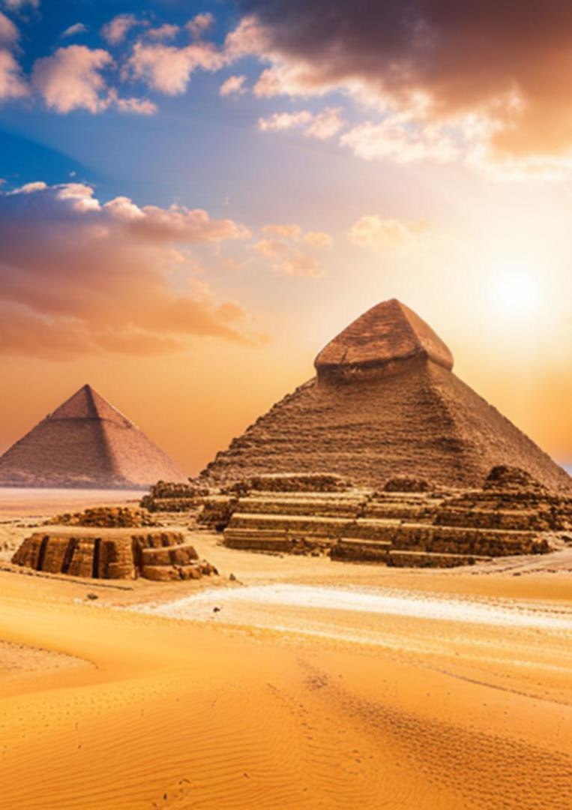
Our project aims to develop an Augmented Reality (AR) tourism application to enhance tourists’ experiences in Egypt by providing real-time information about historical sites.
The primary goal of this project is to offer an application that is both user-friendly and informative.
Description and purpose

Slide 6
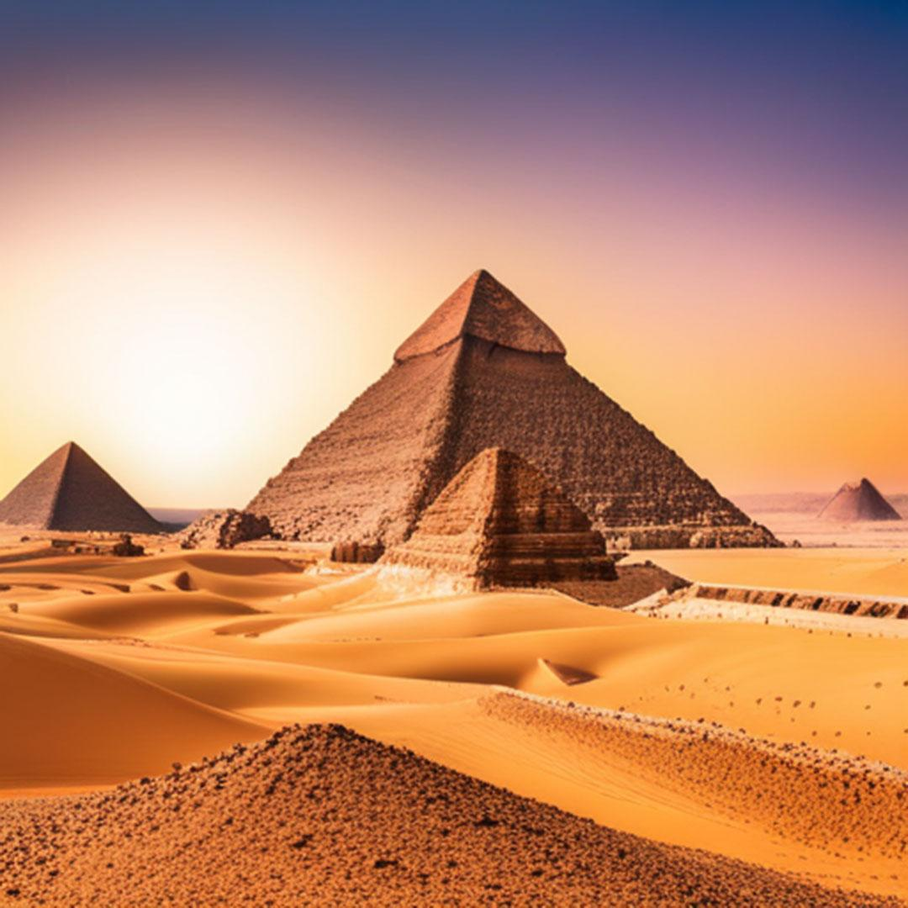
Scope
Application development
multimedia content
admin panel
GPS
Out of scope:
offline functionality
payment features
indoor navigation

Slide 7
Deliverables
Mobile application with an intuitive, easy-to-use interface available on both iOS and Android platforms, GPS tracking, and AR functionalities.
engaging content
load times under three seconds.

Slide 8
Stakeholders
project management
app development teams
Ministry of Tourism
Content creators
UI/UX designer
Quality assurance and testing teams
Tourists
Legal and compliance team
Translation providers.

Slide 9
Assumptions
Users will have internet access during app use
Historical info will be verified
Periodic updates
The app will be available on ios and android
Users can share content

Slide 10
Constraints
Optimize the app for low-bandwidth areas
Potential decrease in app performance during peak tourist seasons
Reduced AR effectiveness in low-light environments.

Slide 11
Timeline and budget
The project is scheduled for completion within three months, with a total budget of $500,000.

Slide 12
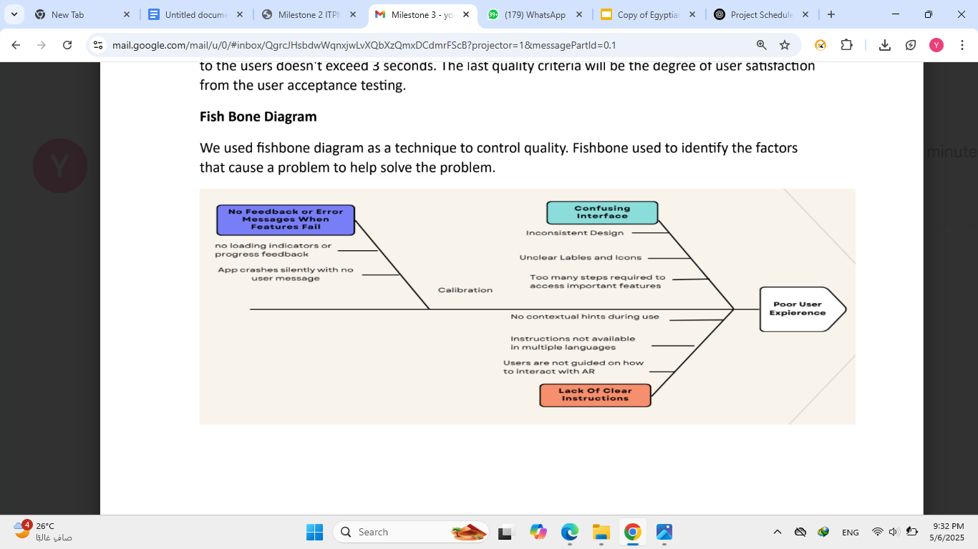
Quality Management
Unit testing, ex: testing GPS accuracy
Integration testing of several components
System testing for the whole application
UAT
Fishbone diagram to control quality

Slide 13
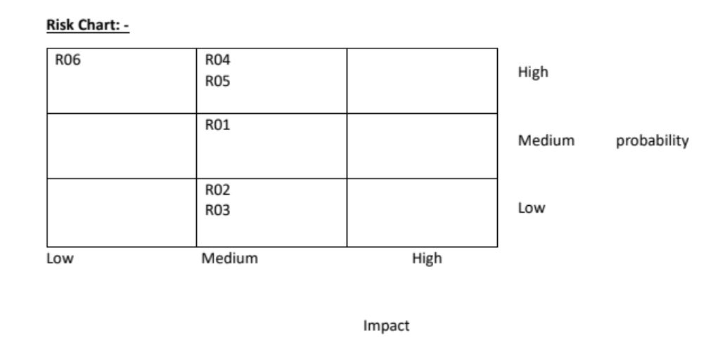
Potential risks
Scalability issues
Hard UX/UI usability
Scope creep
Data quality
Emerging technology

Slide 14
Procurement
voice-over and narration services (voice123, fiverr, voices.com)
cloud-based server (AWS, IBM, Microsoft azure)
software license for design purposes (figma, sketch, adobe creative cloud)

Slide 15
2
Demo

Slide 16

Demo

Slide 17
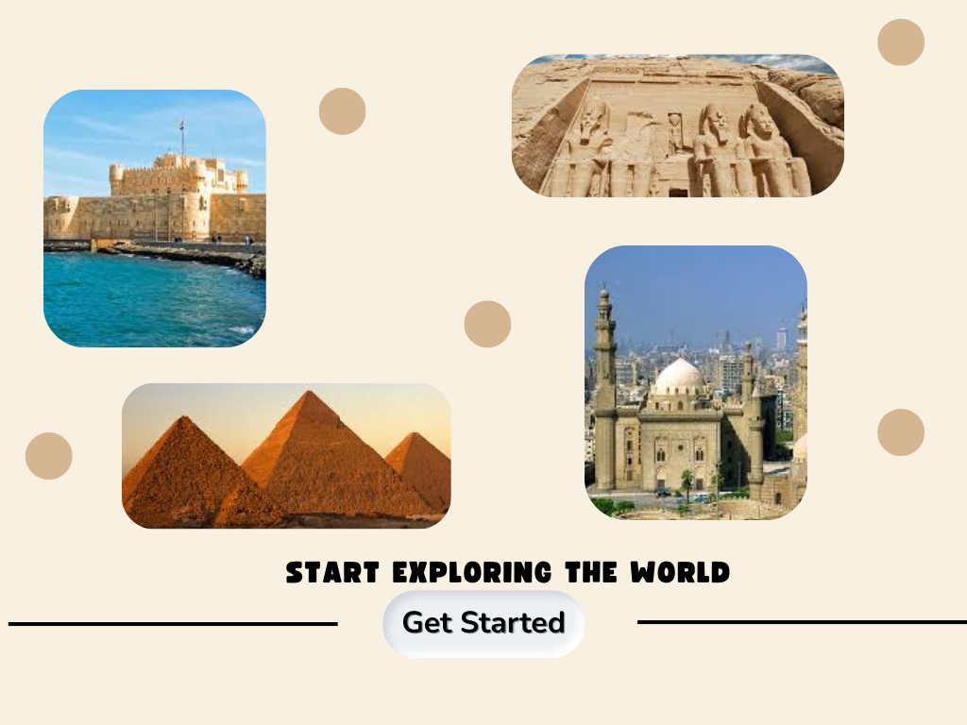

Slide 18
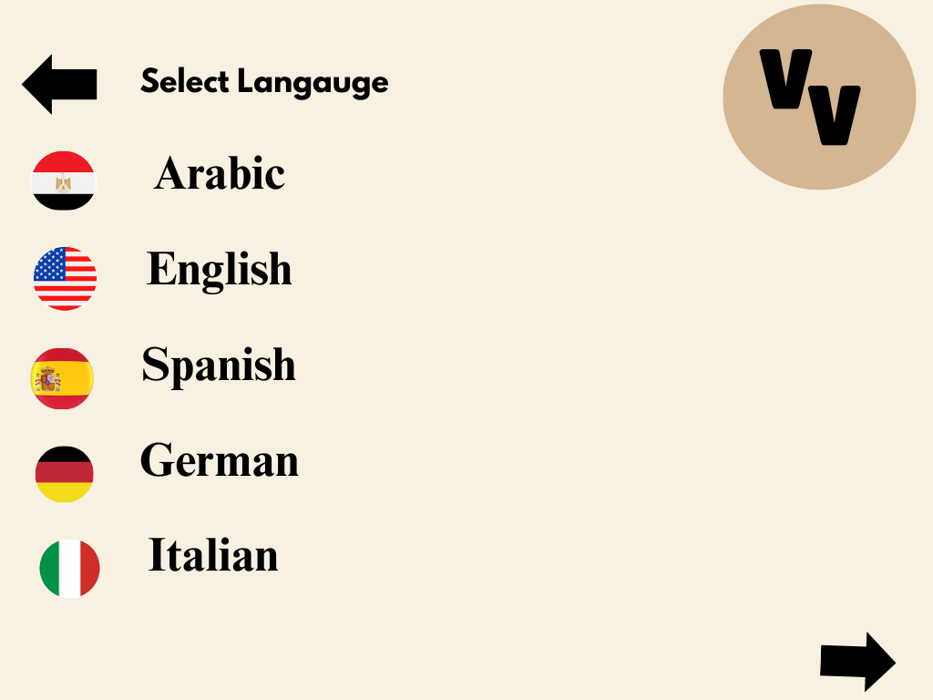

Slide 19
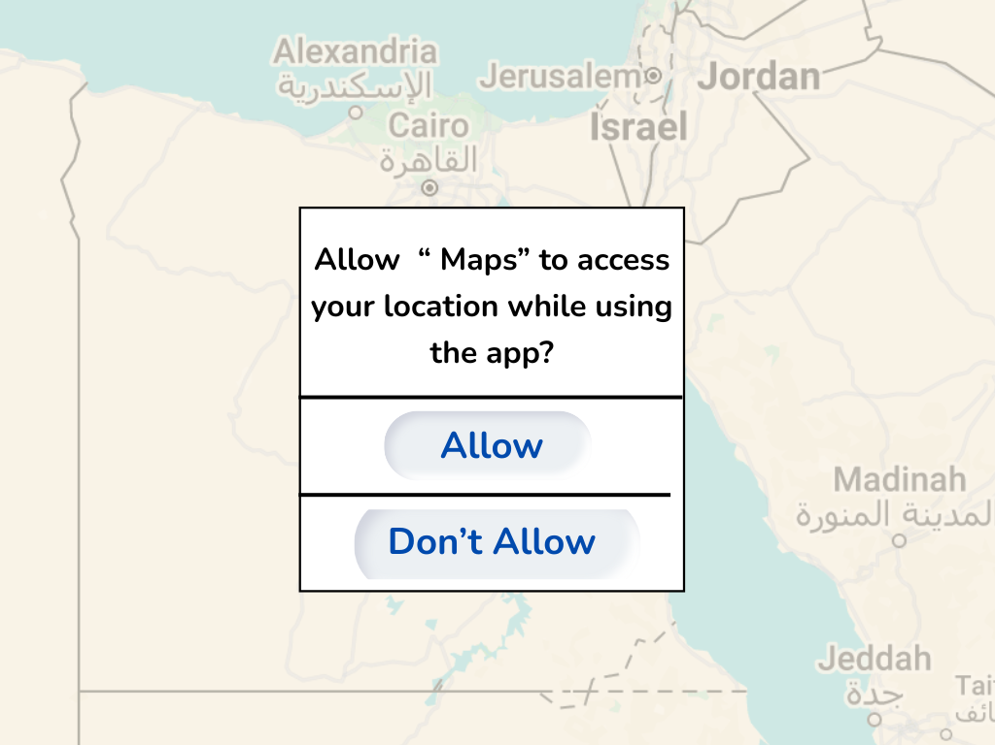

Slide 20
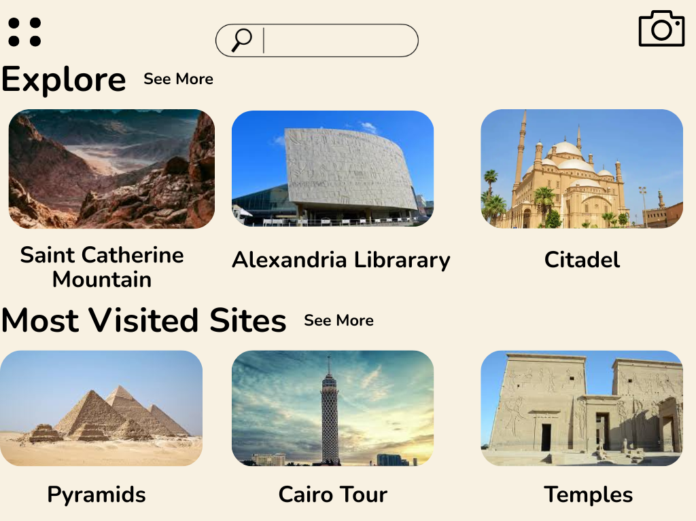

Slide 21
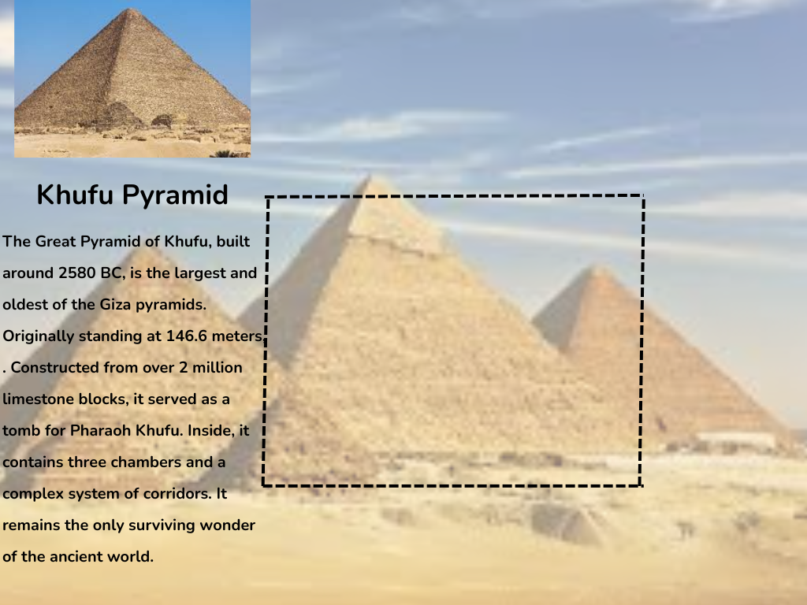

Slide 22
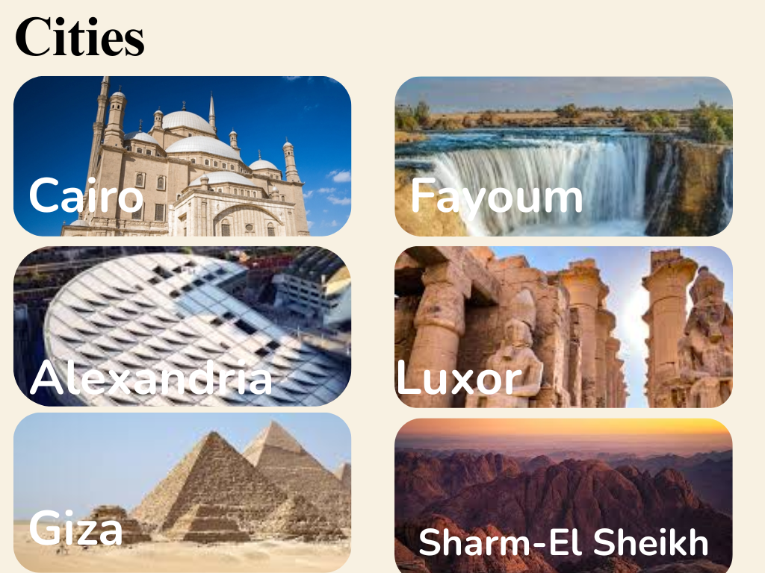

Slide 23
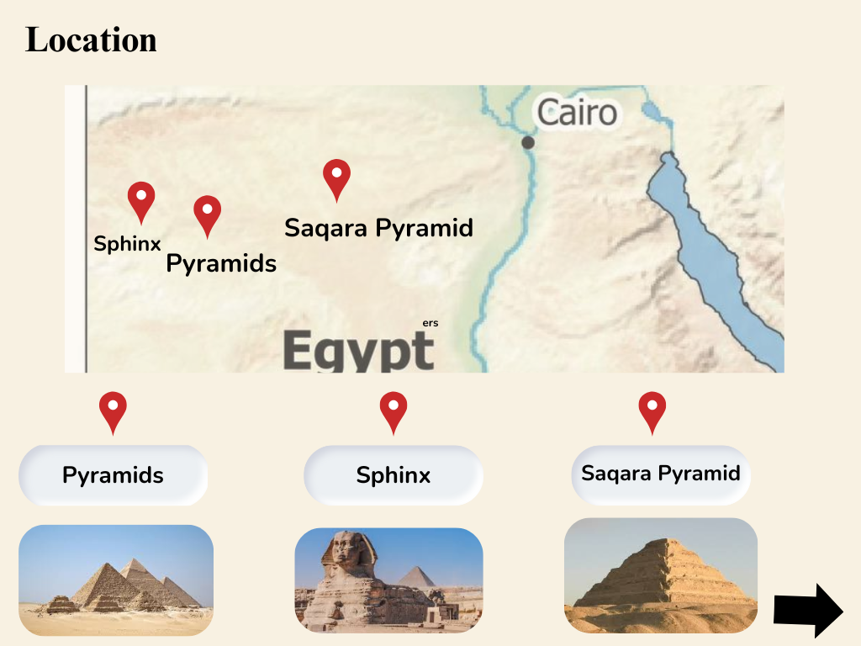

Slide 24
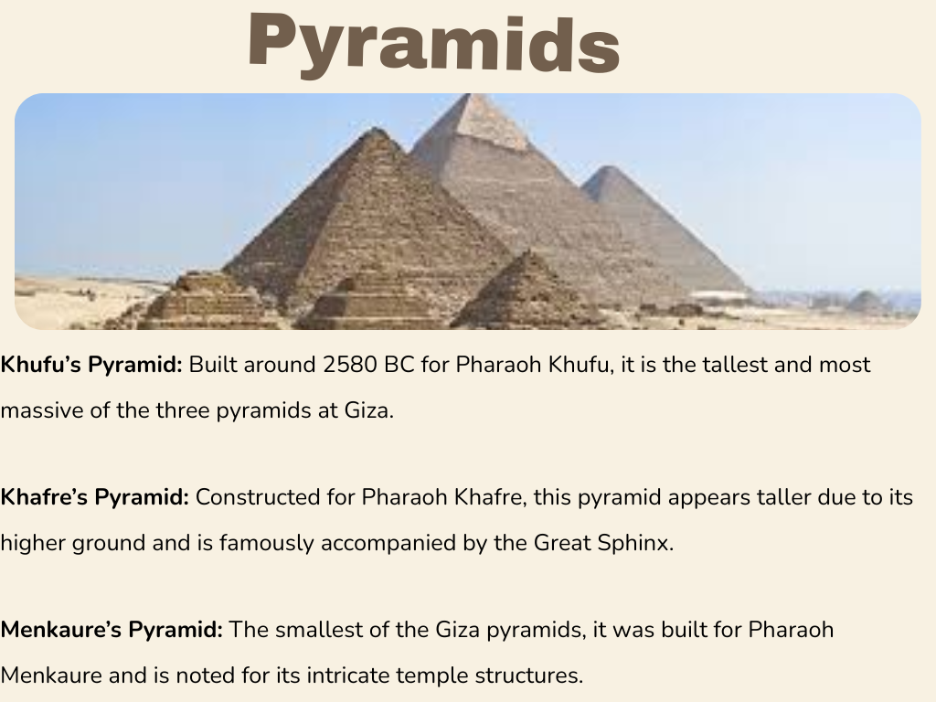

Slide 25
3
Results

Slide 26
Results
Supports multiple languages for wider accessibility
Developed AR experiences for major Egyptian landmarks
Designed a mobile-friendly, tourist-focused user interface
Integrated interactive features to enhance cultural engagement

Slide 27
4
Lessons Learned

Slide 28
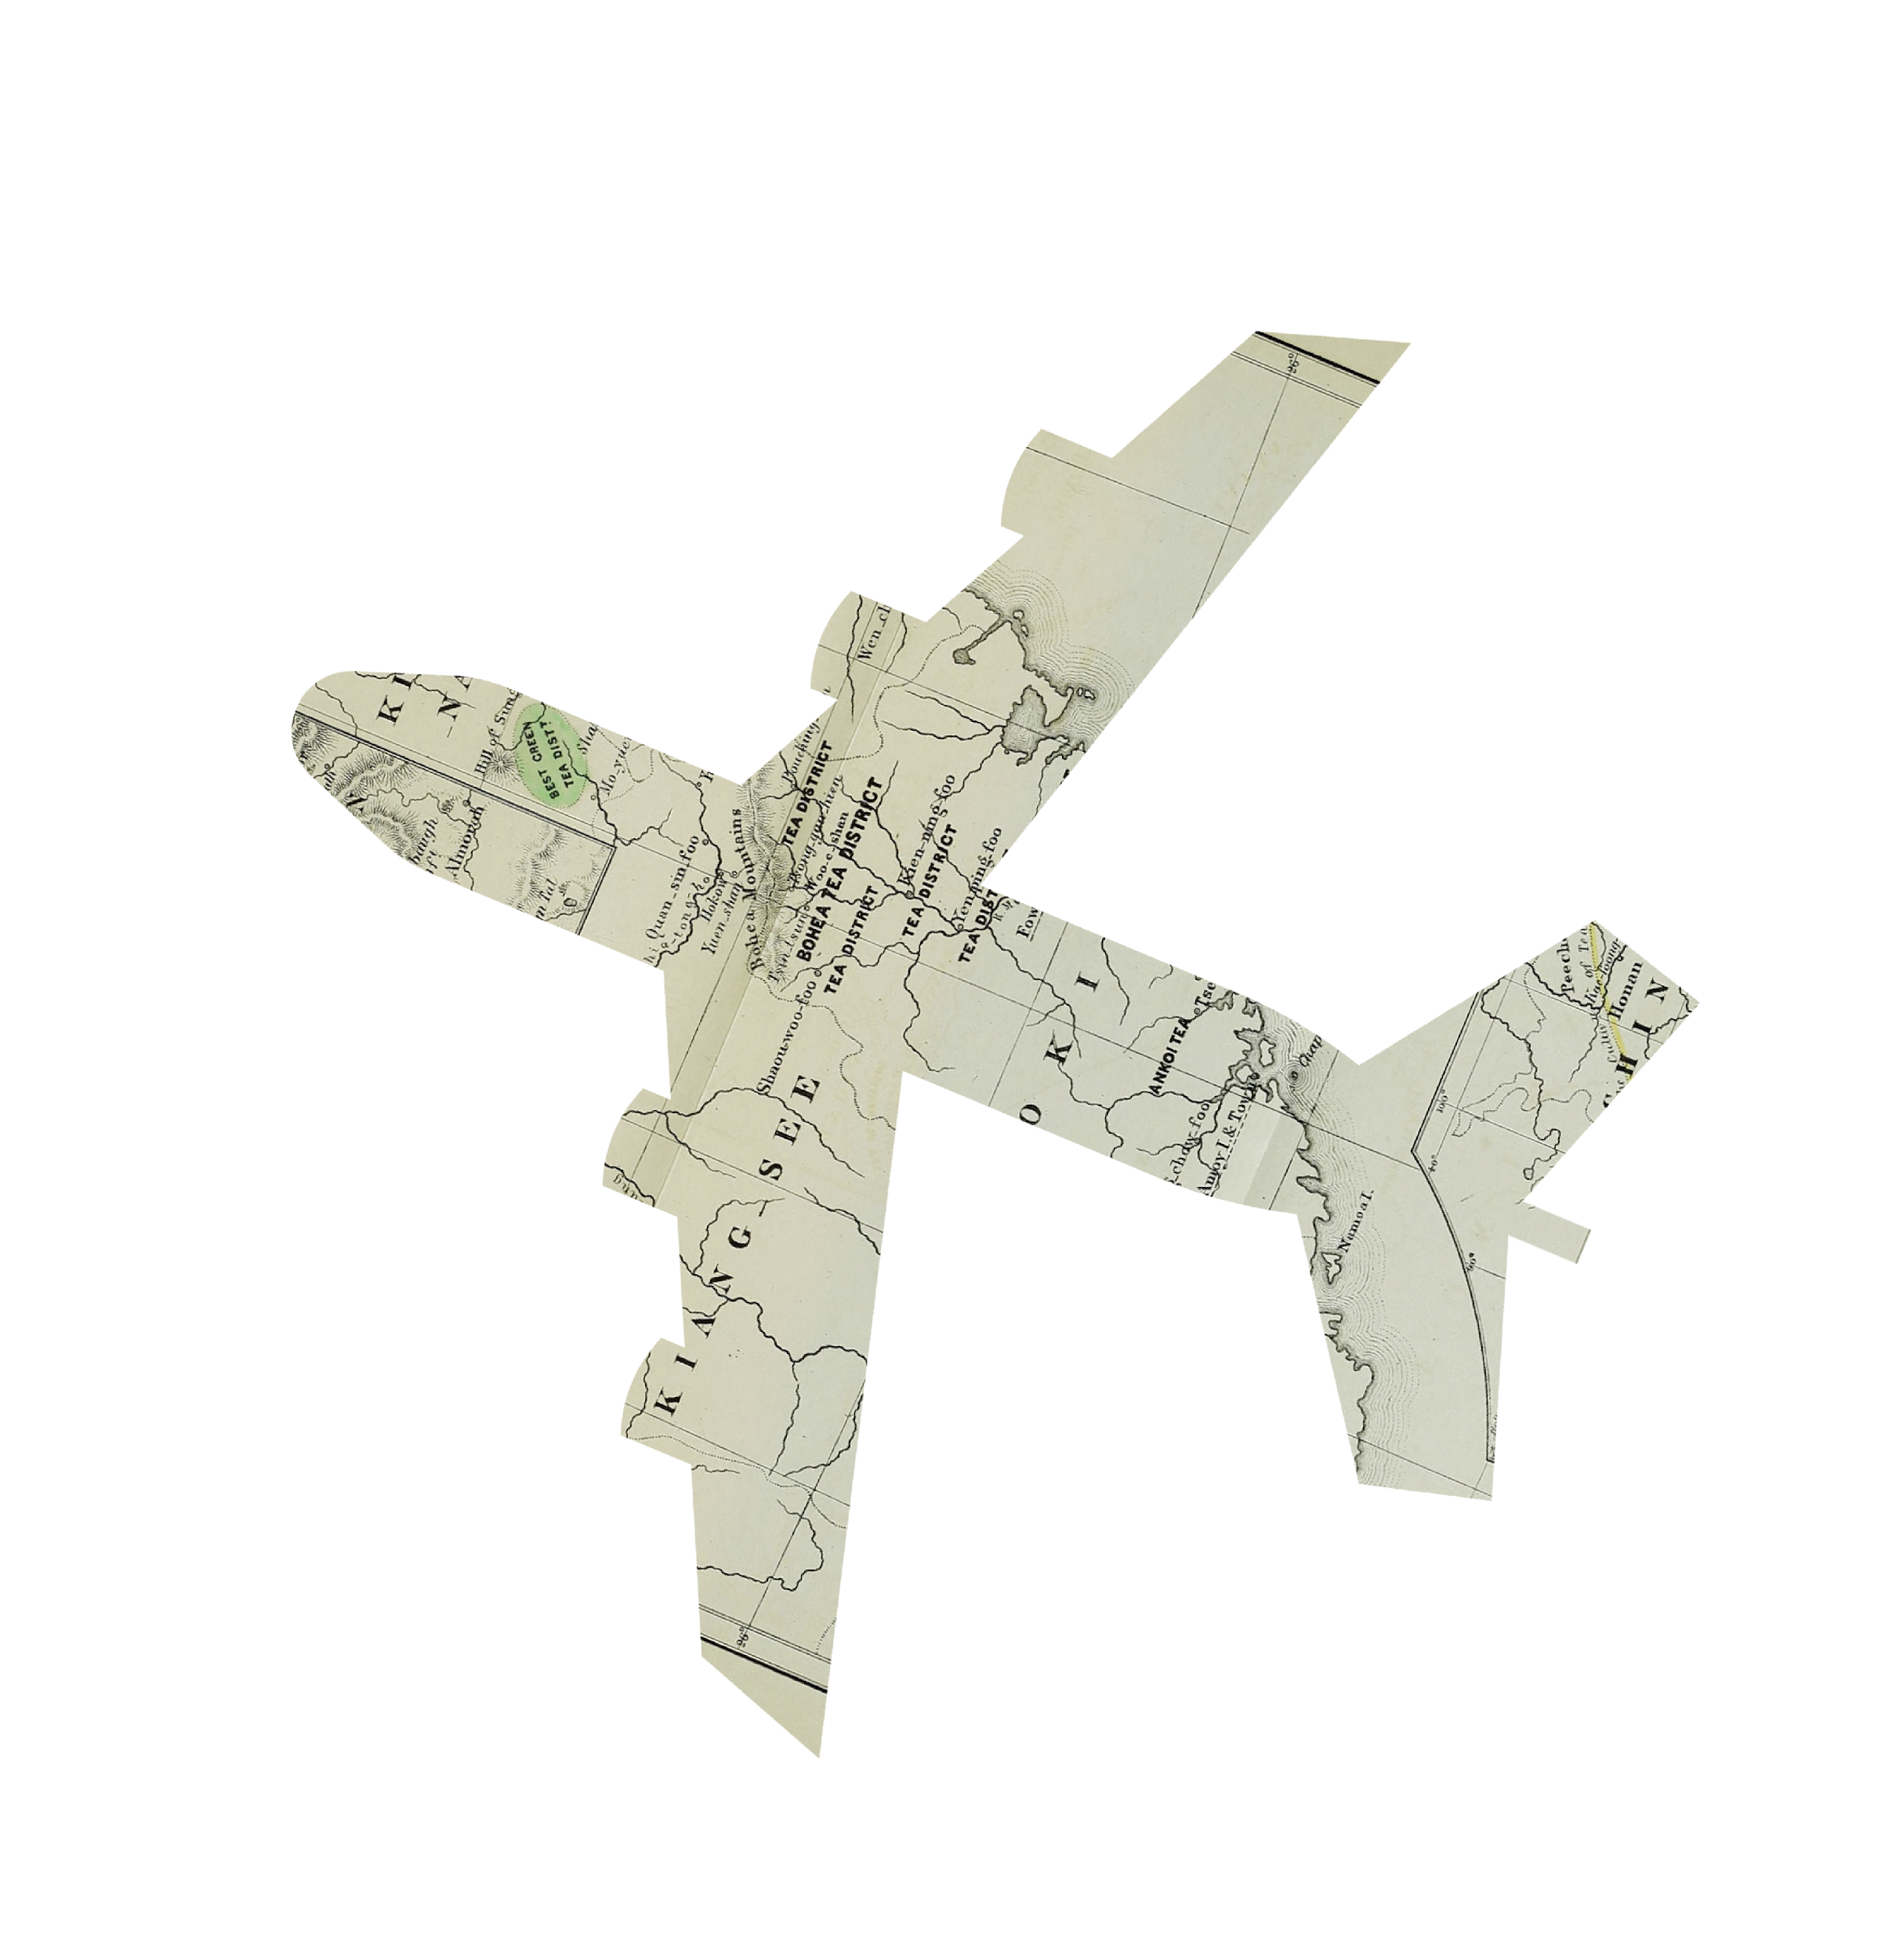
📚 Lessons Learned
Importance of Defining Scope Early
Stakeholder Involvement Is Critical
Testing Across Real Scenarios is Crucial
Budget and Timeline Discipline Pays Off

Slide 29
🎯 Success Criteria
Clear Project Scope and Objectives.
Planning was solid — we created a detailed WBS, timeline, and success
Budgeting was realistic and well distributed across all project needs.
Stakeholder Alignment

Slide 30
⚠️ Challenges Faced
Performance constraints in lower network speed areas
AR didn’t always work well in low light or with unclear visuals.
During crowded seasons, the effectiveness of the application can decrease due to the congestion.

Slide 31
Recommendations
Add Guided Audio Tours & Background Music
Implement advanced Personalized Content
Improve Visual Feedback in AR
Build a User Journey Tracker

Slide 32
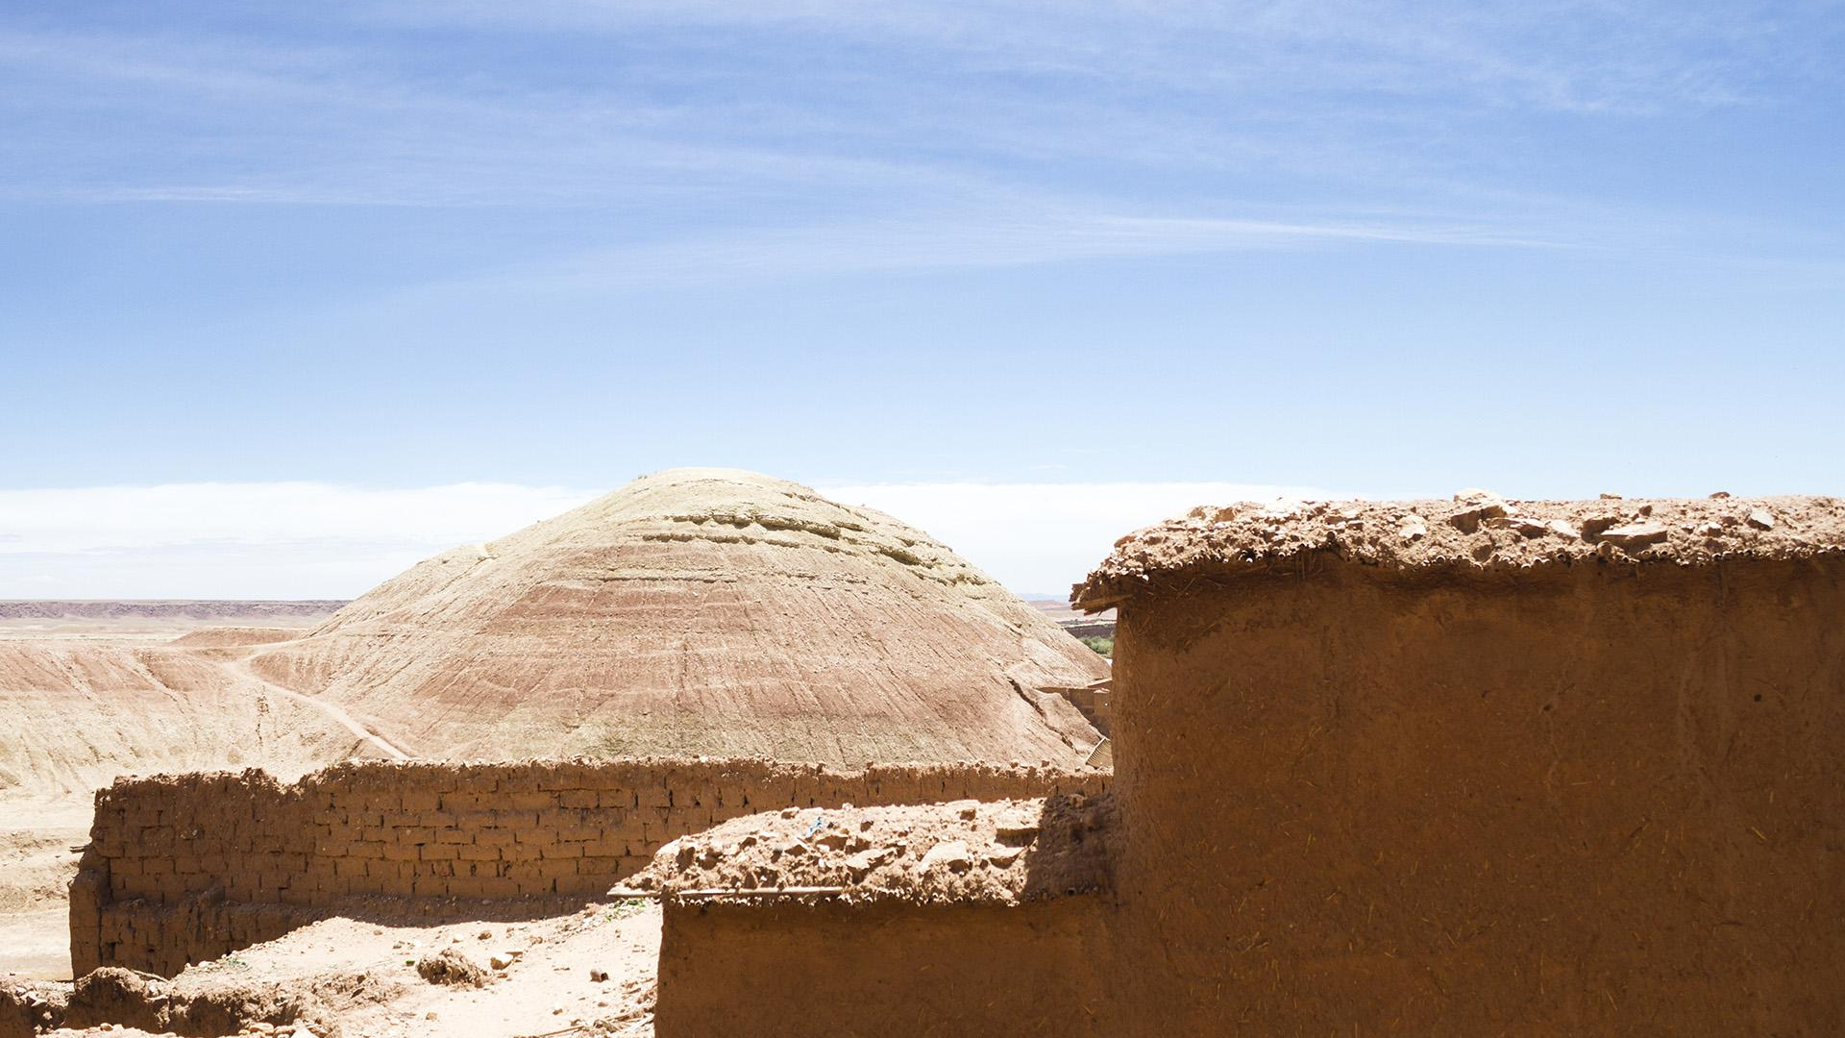
Conclusion

Slide 33
THANKS!
Does anyone have any questions?

